Slide 1


PUZZLES

Slide 2
Question 1
There is a number which is very peculiar. This number is three times the sum of its digits. Can you find the number.
18
45
62
27
Notes:
D

Slide 3
Question 2
Eight friends P, Q, R, S, T, U, V and W, are sitting in the same order anticlockwise around a circular table at equal distance between them with all facing centre of the table. If Q is sitting in the south-east, then in which direction is W sitting?
North-east
North
South-west
South
Notes:
ANS:C

Slide 4
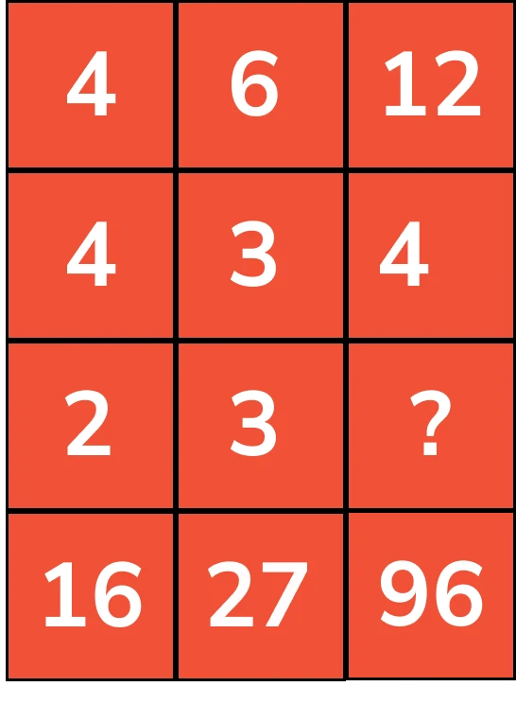
Question 2
Notes:
ANS:6
Step 1: Find whether there is any relation between the numbers in vertical rows.
4+4 = 8 ; 8*2 = 16
6+3 = 9 ; 9*3 = 27 (Relation satisfies)
Step 2: As vertical rows satisfy the relation, there is no need to find whether there is any relation between the numbers in horizontal columns.
Therefore to solve “?”
12+4 = 16 ; 16*? = 96 => 96/16 = ? => ? = 6
Therefore the value of? is 6.
Note: Here the unknown variable is in the third row, so we related the first, second, and last row.

Slide 5
Question 4
An Art and Culture exhibition is being organised in Pondicherry. 5 different states will represent their art in the exhibition during six days of a week, starting Monday and ending on Saturday. One of these days shall be a rest day. - The five participating states include - Andhra Pradesh, mango, Punjab, Uttarakhand and Gujarat - Only one state can put up their exhibition per day - The rest day is between the days when Andhra Pradesh and Gujarat exhibit their art - Punjab will put up their art work right before Uttrakhand - There is a gap of 2 days between Gujarat and Punjab’s exhibition. Gujarat organised the exhibition before Punjab - mango does not organise the exhibition on Saturday.
Which is the rest day?
Monday
Wednesday
Saturday
Friday
Tuesday
Notes:
ANS:D
Monday - mango
Tuesday - gujarat
wednesday - rest day
thursday - andhra pradesh
friday - punjab
saturday - uttarakhand

Slide 6
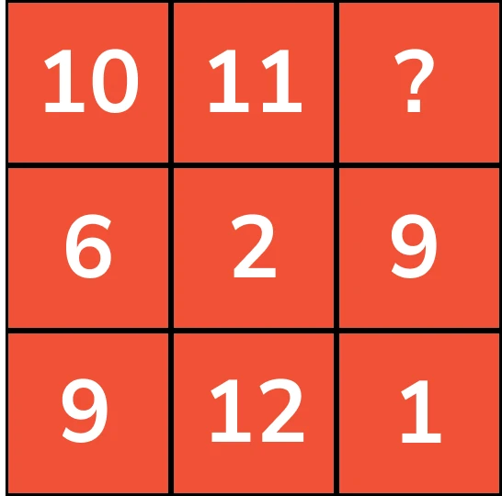
Question 5
Notes:
ANS:15
Step 1: Find whether there is any relation between the numbers in vertical rows.
10+6 = 16 ; 16+9 = 25
11+2 = 13 ; 13+12 = 25 (Relation satisfies)
Step 2: As vertical rows satisfy the relation, there is no need to find whether there is any relation between the numbers in horizontal columns.
Therefore to solve “?”
10+? = 25 ; => 25-10 = ? => ? =15
Therefore the value of ? is 15

Slide 7
What number can be placed in the ?
16
14
20
18
6 | 18 | 54
4 | 17 | 34
8 | 4 | ?
Notes:
ANS: 54/18=3+3=6
34/17=2+2=4
16/4=4+4=8

Slide 8
What number can be placed in the ?
6 8 10
7 5 9 7 11 9
77
81
87
71
41
?
109
Notes:
D
7*5*6=41
9*7*8=71

Slide 9
What number can be placed in the ?
41 | 22 | 33 | 25
19 | 20 | 13 | ?
14 | 10 | 8 | 30
8
4
5
3
Notes:
D
41-19-8=14
22-20+8=10
25-3+8=30

Slide 10
What number can be placed in the ?
27
30
18
36
6 | 4
3 | 72
-1 | 4
-2 | 8
2 | 9
2 | ?
Notes:
D
3*6*4=72
-2*-1*4=8
2*2*9=36

Slide 11
What number can be placed in the ?
5
6
7
8
12
6 | 4
80
20 | 8
63
? | 21
Notes:
B
4*3=12-->3+3=6
8*10=80-->10+10=20
21*3=63-->3+3=6

Slide 12
What number can be placed in the ?
36 | 21 | 42
? | 4 | 7
6 | 7 | 7
5
6
7
8
Notes:
C
7*7=49-7=42
6*7=42-6=36

Slide 13
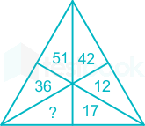
Select the number from given options which can be placed at ? a)12 b)14 c)17 d)18
Notes:
Ans option b
Logic: For each pair of vertcially opposite angles number1=number*3 (14*3=42)

Slide 14
Find the missing number
a)6
b)8
c)10
d)12
3 | 2 | 2
6 | 20 | 4
12 | 25 | 64
6 | 10 | ?
Notes:
Ans option b-8
logic column I 3*6*12=216=6^3
column II 20*25*10=1000=10^3
column III 2*4*64=512=8^3

Slide 15

Find the missing number
a)10
b)3
c)1
d)34
Notes:
Ans oprtion c-1
Logic 1st row remainder of (27/4)=3
2nd row remainder (17/6)=5
3rd row remainder (31/3)=1

Slide 16
Find the missing number
7 | 13 | 174
9 | 25 | 104
11 | 30 | ?
a) 335
b)129
c)431
d)100
Notes:
Ans option c 431
logic-In each Row (1st number)^3 – (2nd number)^2 = 3rd number
For example 2nd row 9^3-25^2=104

Slide 17
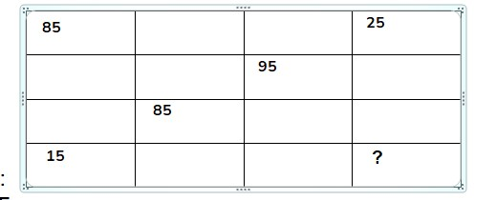
A) 15
B) 85
C) 95
D) 25
Notes:
Ans 95

Slide 18
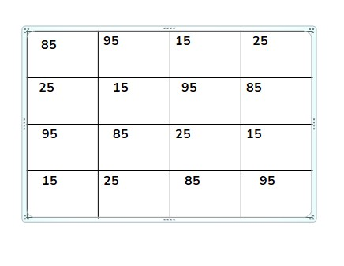

Slide 19
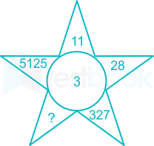
Find the missing number
Notes:
Ans option c-464
Logic -The first clue lies inside the circle the number 3 which act as a cube for all numbers
For example 11 is written as 1 and 1^3=11
28 is written as 2 and 2^3=28
327 is wriiten as 3 and 3^3=327
5125 is wriiten as 5 and 5^3=5125
So therefore 4 and 4^3 =464

Slide 20
A family I know has several children. Each boy in this family has as many sisters as brothers but each of the girls has twice as many brothers as sisters. How many brothers and sisters are there?
1and 2
2 and 3
6 and 3
4 and 3
Notes:
D

Slide 21
A man carries 3 sacks with 30 mangoes each. As he crosses each toll he has to give 1 mango for each sack. He crosses total 30 tolls. How many mangoes he will have at the end.
30
0
25
20
Notes:
C

Slide 22
Fifty minutes ago if it was four times as many minutes past three ‘o'clock, how many minutes is it until six ‘o'clock?
26 minutes
30 minutes
45 minutes
60 minutes
Notes:
A

Slide 23
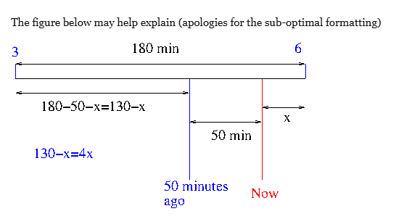

Slide 24
What number can be placed in the ?
2 3 6
3 2 4 2 3 5
4 5 4
123
33
90
86
33
54
?
Notes:
D

Slide 25
